Slide 1

网络犯罪
XU, Hui
xuh@fudan.edu.cn
December 20, 2020

Slide 2
关于网络安全学习
我们已经学过很多攻击方法
网络和协议漏洞，如DDoS、ARP和DNS缓存中毒
内存漏洞攻击，如缓冲区溢出、释放后使用
为什么了解攻击方法很重要？
在设计系统时像攻击者一样思考问题
帮助工程师在系统或软件中避免常见的安全问题

Slide 3

攻击方法和攻击者
攻击者都是什么人？他们的动机是什么？
过去，“Hacking”主要是关乎荣誉
31337 hackers vs. script-kiddies/n00bs
编写病毒，网页篡改
如今，“hacking”主要是和钱相关
有组织的犯罪
多个角色、不同技能
Th1s s3nt3nc3 1s wr1tt3n 1n b4sic l33t.
50meth1n9 l1k3 th15.
l33t to |_&€”|”
Pwn
own
N00b
newbie
https://alpinesecurity.com/blog/leetspeak-the-history-of-hacker-culture/

Slide 4
黑产相关
攻击脚本开发
软件逆向
出售攻击软件
僵尸网络管理
开发软件控制海量僵尸电脑
外租botnet盈利给其他黑客
垃圾邮件发送者
为其他黑客广播链接
钓鱼
设置仿造网站窃取用户信息
和垃圾邮件发送者合作获利
商品仿造
卖假货
需要信用卡收款渠道
防弹主机服务
出售专用主机给其他黑客
部署在互联网法律监管盲区
造卡、套现、走私
银行卡变现
洗钱
Crowdturfers
创建和管理虚假账号
出售校验码CAPTCHAS服务

Slide 5
1. 地下论坛
Franklin, et al. “An Inquiry into the Nature and Causes ofthe Wealth of Internet Miscreants” CCS 2007

Slide 6
地下电商
很多从事非法交易的人
漏洞攻击脚本开发者
僵尸网络运营
垃圾邮件和搜索引擎优化广告
造卡和套现
类似其它经济活动，需要渠道进行商品买卖
IRC聊天室
地下论坛
一般使用洋葱网络隐藏的服务

Slide 7
互联网非法获利研究
2007年，研究分析了7个月的地下IRC聊天室日志
1300万条消息
买方、卖方、和骗子
管理员验证买家的可信性
骗子窃取正常买家的财产或者卖假货
大多数消息都是广告
实际交易都是通过私下消息进行

Slide 8
广告
参与者需要商品或服务
“我有XXX银行的登录账号”
“出售邮件发送服务”
“我需要1张master卡，用1个linux账户交换”
其它人发送样例证明他们有某些数据
Name: Phil Phished
Address: 100 Scammed Lane, Pittsburgh, PA
Phone: 555-687-5309
Card Number: 4123 4567 8901 2345
Exp: 10/09 CVV: 123
SSN: 123-45-6789
CHECKING 123-456-XXXX $51,337.31
SAVINGS 987-654-XXXX $75,299.64

Slide 9
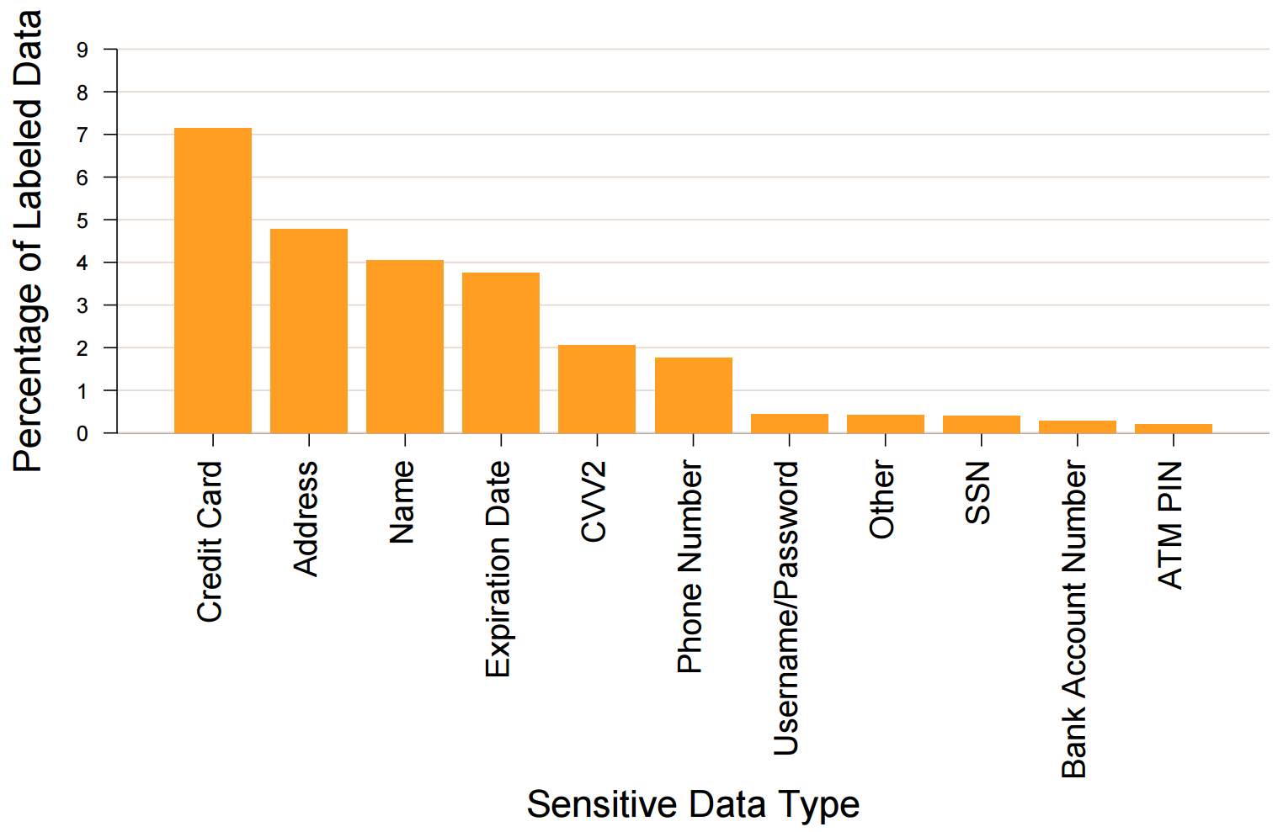
敏感数据

Slide 10
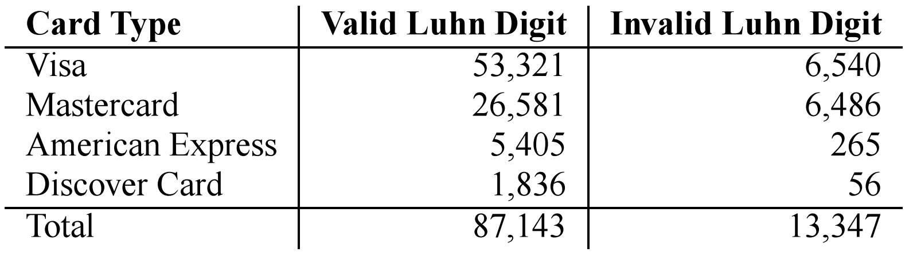
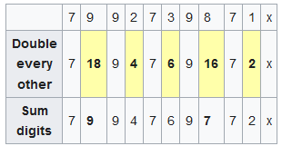
信用卡是否有效？
信用卡号末位数据为校验码
校验算法非常简单，可以验证信用卡是否为真
卡号通过校验还不够
可能被吊销、或者超过限额
根据luhn算法，x=3。
https://en.wikipedia.org/wiki/Luhn_algorithm

Slide 11
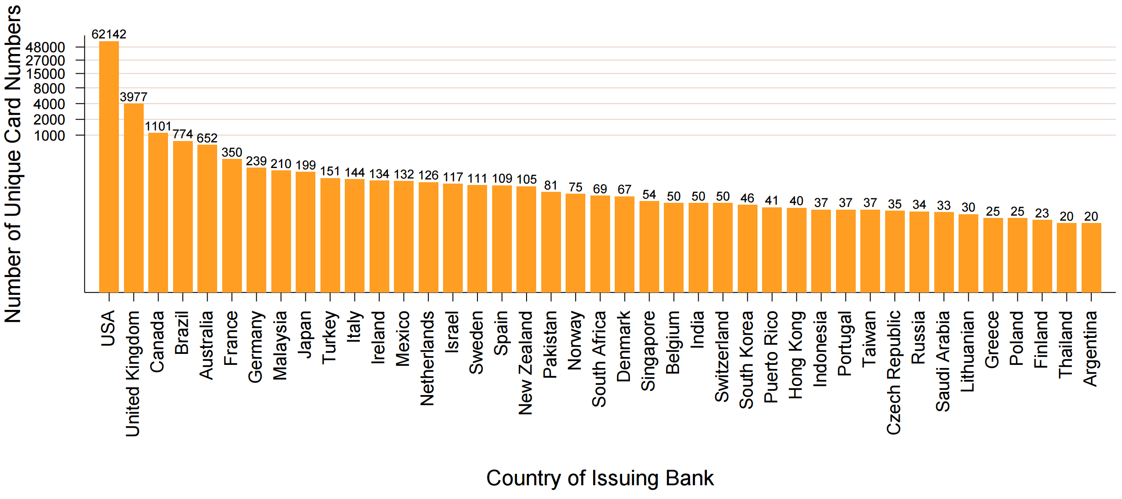
信用卡发型地

Slide 12
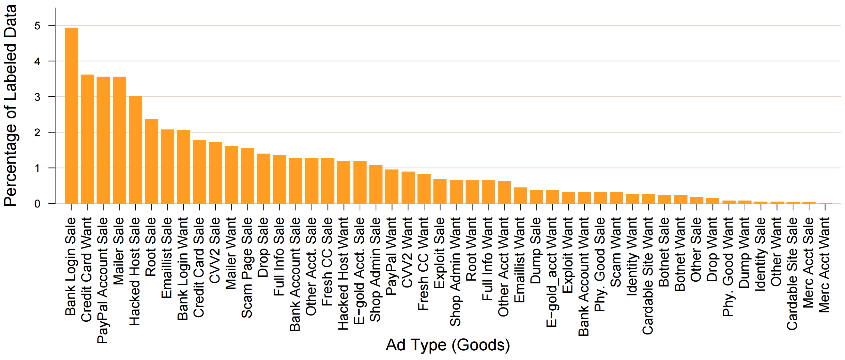
广告商品类型
账户和个人信息
垃圾邮件、钓鱼网站
刷卡和转账
入侵主机
攻击脚本
僵尸网络

Slide 13
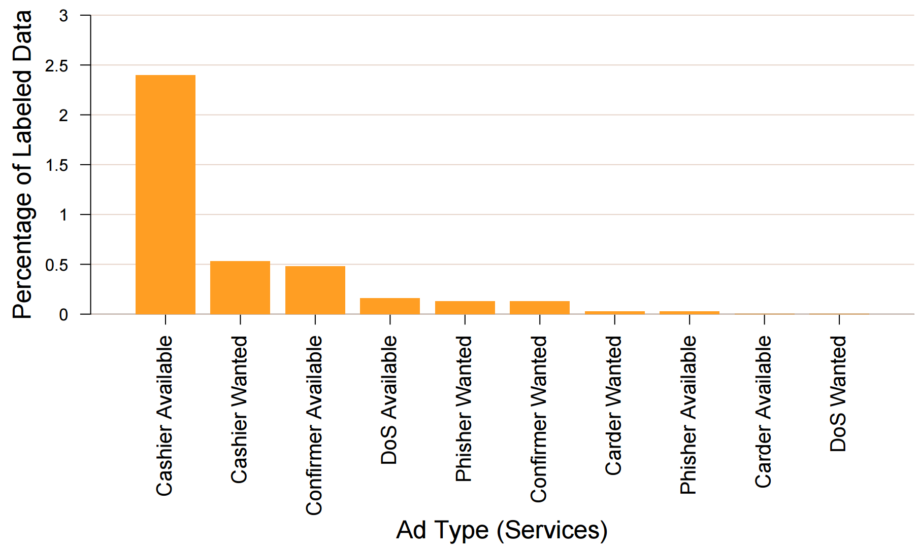
服务
制卡者：伪造信用卡并且购买高额商品
确认者：实地确认转账操作
变现者：从银行取出现金并收取出部分酬劳

Slide 14
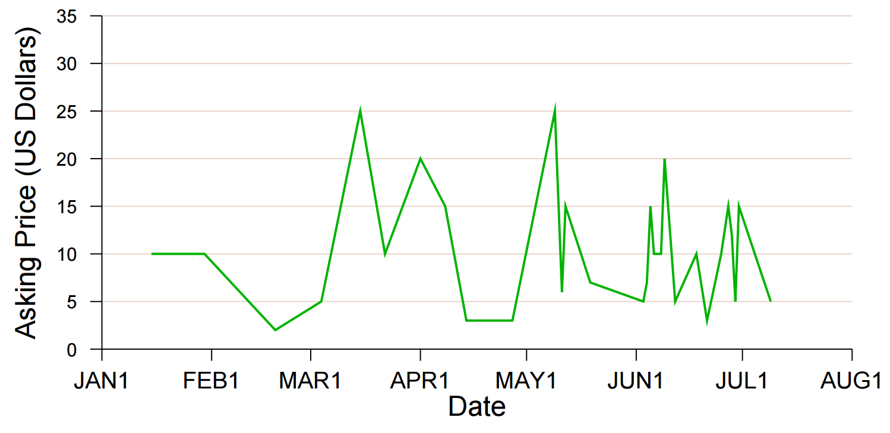
商品价格
入侵主机的价格

Slide 15
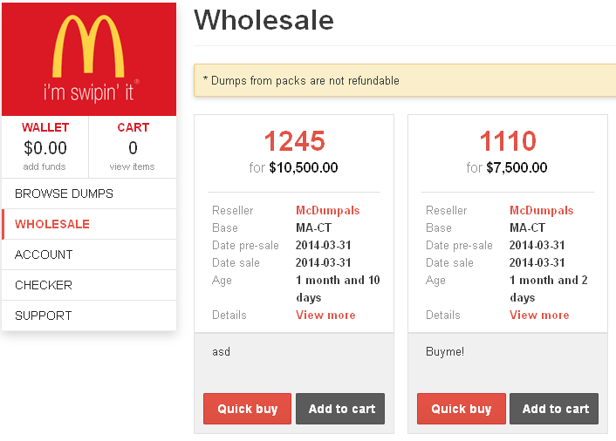
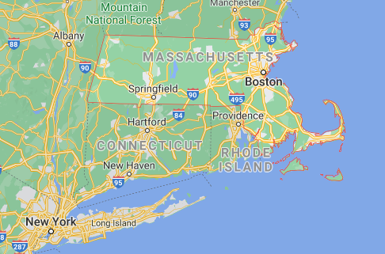
McDumpals商店贩卖信用卡数据

Slide 16
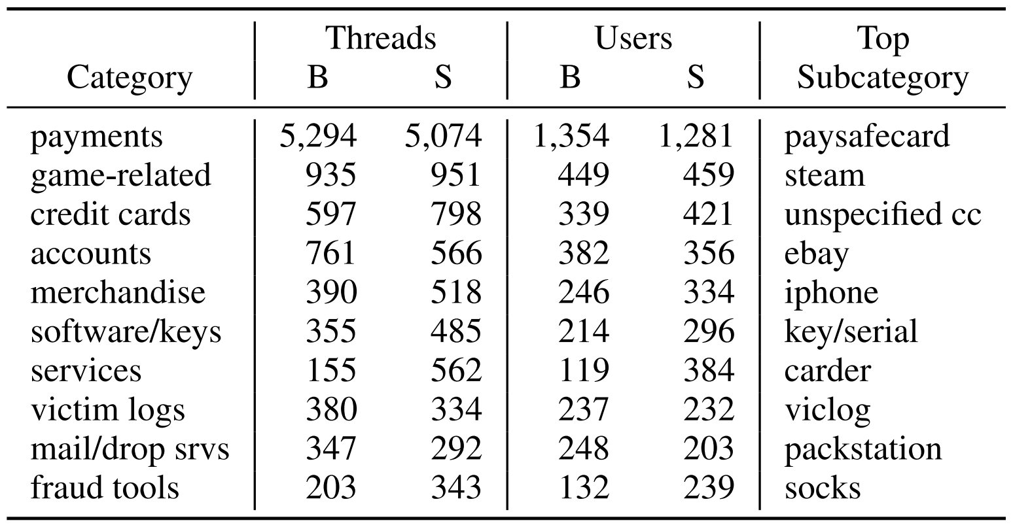
地下论坛分析
2008-2010
用于洗钱
Buy
Sell
Buy
Sell

Slide 17
地下论坛总结
地下论坛非常普遍
很多是地上网站，能够通过Google搜索到
很多非法商品和服务出售
法律制裁一般针对特定的论坛或平台
新的平台会出现
了解黑市论坛对于安全工作者很重要
了解地下技术的发展
白帽子可以发现新的攻击趋势，预防未扩散的攻击

Slide 18
2. 电商欺诈
Peng Wang, et al. Into the Deep Web: Understanding E-commerce Fraud from Autonomous Chat with Cybercriminals, NDSS’20

Slide 19
Problem
People
repeatedly purchase the same products (without paying)
write fake reviews (without purchasing) using fake accounts
to
increase sale volume
manipulate product ranking
earn bonus
They
advertise their services using group chat
seek collaboration via one-on-one interaction.

Slide 20
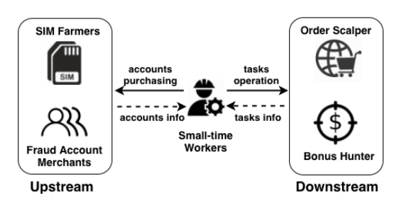
E-Commerce Underground Markets
Upstream
SIM farmers: provide gateway software to forward SMS to clients (account merchants)
Fraud account merchants: provide accounts for others
Downstream
Order scalper: increase sale volume by fake purchases
Bonus hunter: buy certain products (high quality, low price, few inventory) to earn promotional bonus
买手机号
（注册账号）
伪造交易数据
买账号
薅羊毛
（多账号抢）

Slide 21
Challenge
Multicast messages passively received from instant message (IM) groups are less valuable.
Useful intelligence is only shared through one-on-one conversation, which is difficult to manage.

Slide 22
Work Contribution
Designed a chatbot, called Aubrey (AUtonomous chatBot foR intelligencE discoverY), to actively collect threat intelligence through autonomous chats with real-world e-commerce miscreants.
Aubrey chatted with 470 real-world miscreants and gain new insights into e-commerce fraud ecosystem.

Slide 23
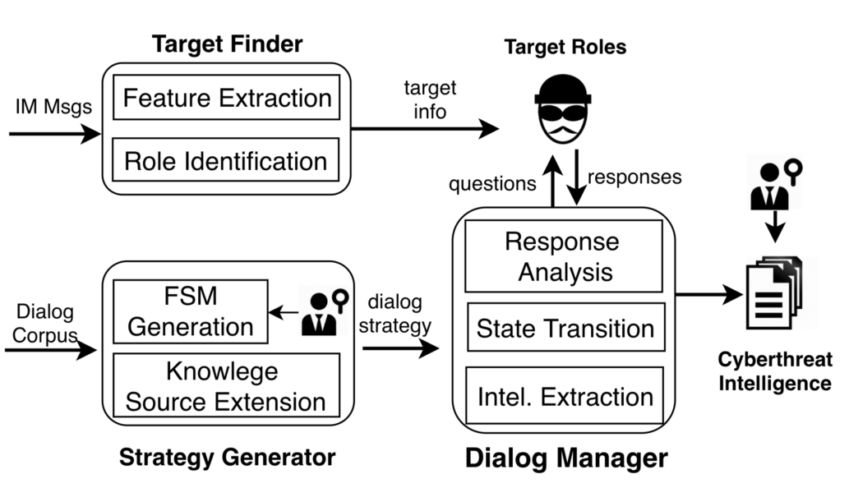
Aubrey
Target Finder: identify miscreants from group chats
Inspect underground IM group messages
Extract features and construct classifiers
Strategy generator: generate dialog strategy from dialog corpus
Construct three Finite State Machines (FSMs)
Extend knowledge
Dialog Manager: chat with target roles
Response analysis
State transition in the FSM
Extract intelligence when the conversation stops

Slide 24
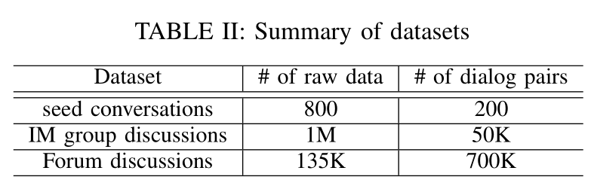
Data Collection
Seed conversations:
20 conversation traces between Company A’s security analyst and miscreant roles
IM group discussion:
From top 50 most active groups for each role
Searched by 50 keywords (provided by company A)
Track for 16 months (2017/07~2018/10)
Forum threads:
htys123.com: 25K threads; 2013/10~2018/10; 250K dialog pairs
zuanke8.com: 110K threads; 2018/06~2018/10; 450K dialog pairs

Slide 25
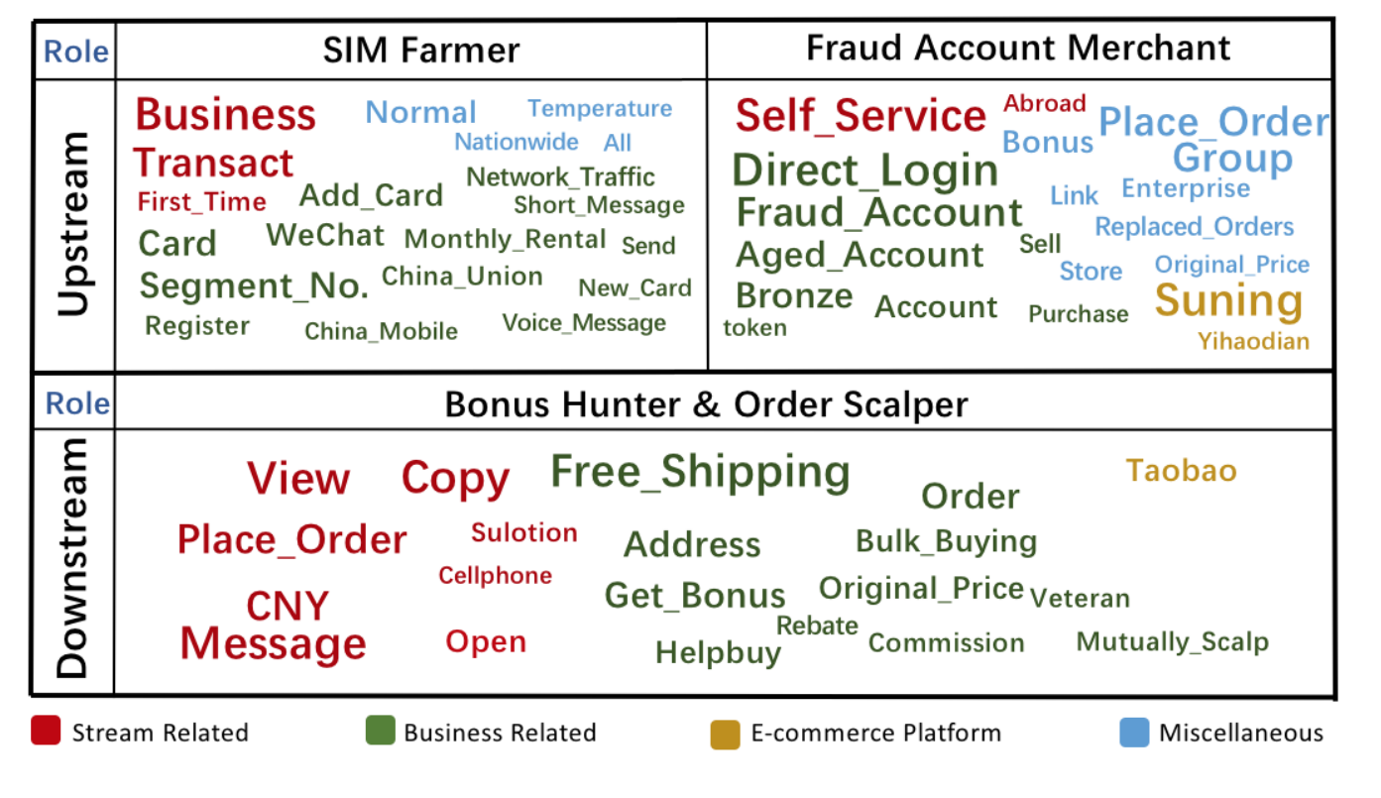
Target Finding
Determine upstream actor, downstream actor or neither
Extract keywords from sentence by odd ratio; calculate z-score to form vectors
Adding avg. length and frequency as feature
Use two SVM models for identifying upstream and downstream actors respectively
For upstream actor: determine SIM farmer or account merchant
Measure the ratio of verb-noun phrases (together with high z-score keywords in account merchant corpus)
Set a threshold to indicate SIM farmer

Slide 26
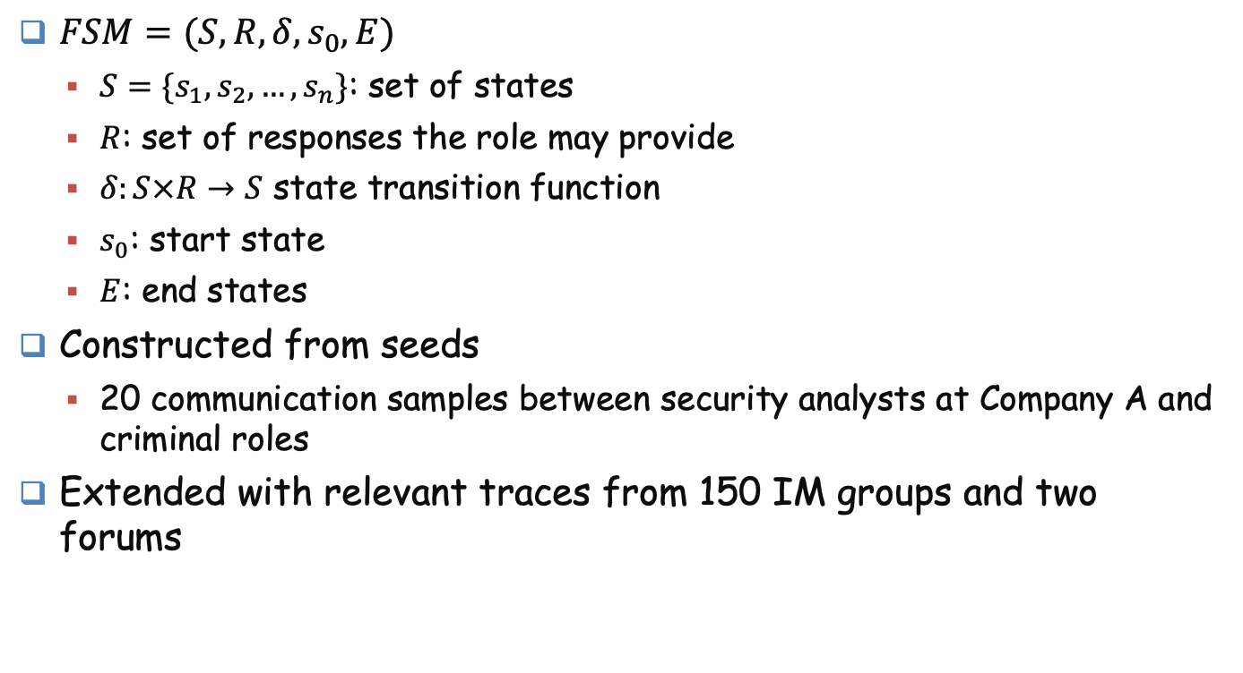
Strategy Generation
$FSM=(S,R,δ,s_{0},E)$
$S=\{s_{1},s_{2},…,s_{n}\}$: set of states
$R$: set of responses the role may provide
$δ:S×R→S$ state transition function
$s_{0}$: start state
$E$: end states
Constructed from seeds
20 communication samples between security analysts at Company A and criminal roles
Extended with relevant traces from 150 IM groups and two forums

Slide 27
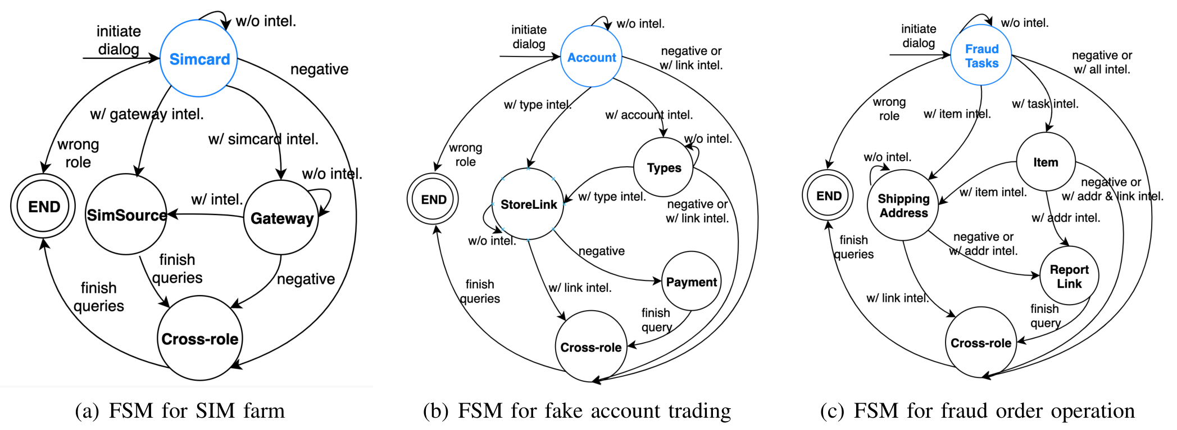
FSM Generation
Discover states
Segment the seeds into dialogue blocks: single-pass clustering + semantic similarity
Determine topic for each dialog block: use keywords related to a given role
Find their transitions: From the relations between different blocks

Slide 28
Knowledge Source Extension
Collect
1 million messages from 150 underground IM groups
135K threads from two underground forums
Segment messages into blocks
Detect questions, use questions and follow-up messages as dialog pairs (750K dialog pairs as retrieval model, 200 used here)
Extract keywords for known dialogue in states (jieba) and expand the list (word2vec)
Filter question pairs with keywords
Add questions which cos sim above 0.9 with questions in the state (sentence embedding)

Slide 29
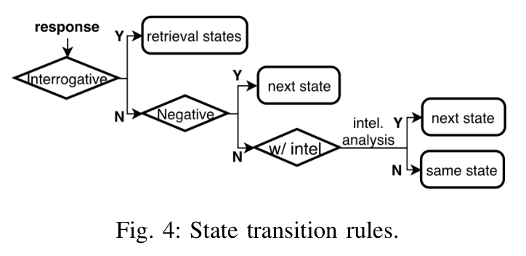
Dialog Manager
Initialization:
Send a greeting
Proceed through different states
Detect negative responses
Language Technology Platform (LTP)
Detect interrogative responses
Rule-based detection (“5W1H” + “?”)

Slide 30
Intelligence Detection
Compare:
Response answer
Dialog pairs of current state
If
Above two sentences are semantically similar; or
Answer include expected entities:
URL (use regular expressions)
Topic words
Represent intelligence as (entity, type) pair, for later state transition

Slide 31
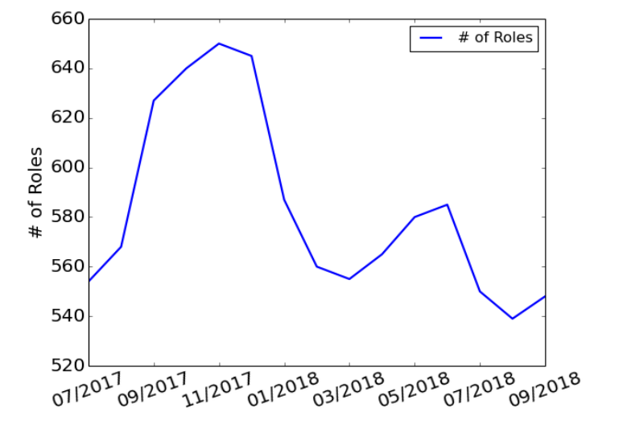
Evaluation: Role identification
Upstream classifier: precision=87.0%, recall=91.2%
Upstream role identifier: precision=89.0%, recall=92.8%
Downstream classifier: precision=81.1%, recall=95.6%
Ran over 20,265 IM group members, reported:
1,044 SIM farmers
700 account merchants
2,648 fraud order operators

Slide 32
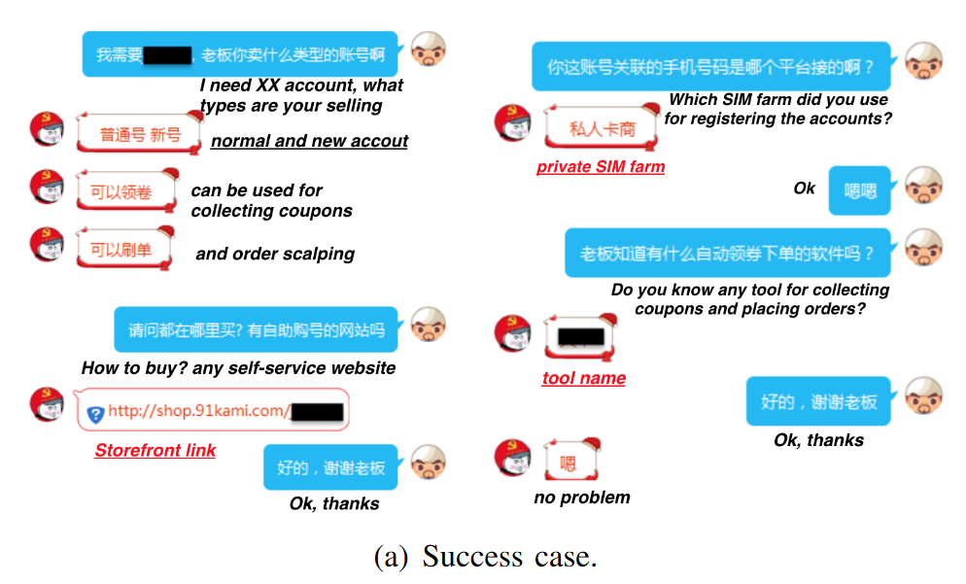
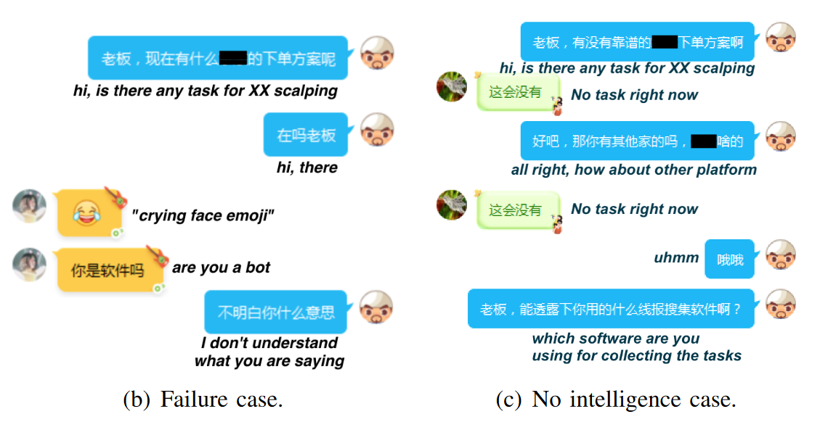
Evaluation
Chat with 545 miscreants
470 chatted successfully (75 not responding), 458 are identified correctly
185 SIM farmer + 130 account merchants + 155 fraud order operator

Slide 33
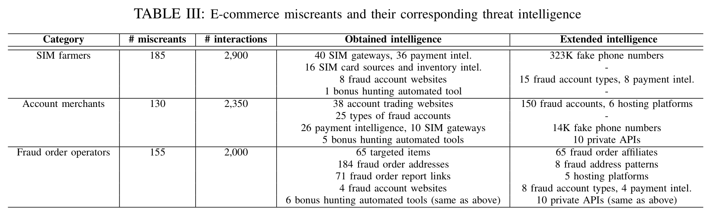
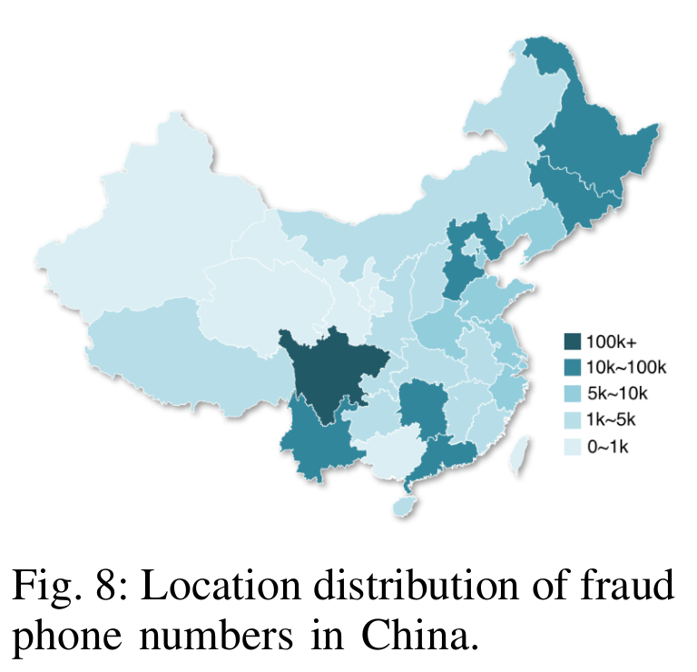
Threat Intelligence Analysis
323K phone numbers
Can register Company A’s account
Distribution in China:
Some from Southeast Asian countries
Send 190K to Company A:
90% being used for registration
72% accounts have been used

Slide 34
Fraud Accounts
Bought 150 Company A’s accounts from 17 merchants
Price: $0.15~$0.65 depend on account type
<username, password, phone number>
Sometimes + <IPs, emails, timestamps>
52.5% accounts have anomalous activity during registration
9.1% has been used
By IPs and phone numbers, 4,252 more suspicious accounts identified

Slide 35
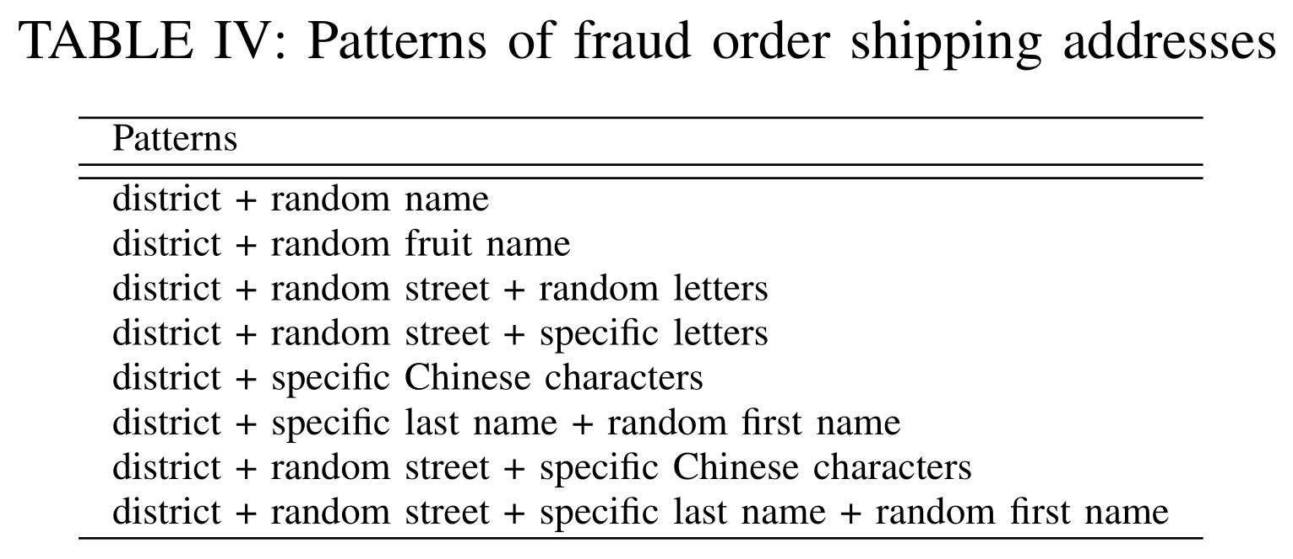
Fraud Orders
Evade detection in shipping addresses:
Randomize the addresses
Collude with the express company officers
Found 4000 fake addresses from 30,000 hunting jobs

Slide 36
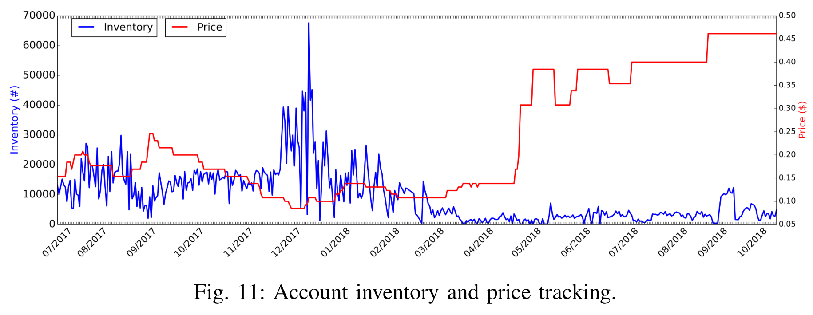
E-commerce Supply Chain
Deep websites do not allow search engines (including dark engine) to index them.
Fraud account marketplaces are running on hosting platform, built upon similar template; 71.4% hosted on cloud services.
Private APIs of Company A are used in bonus hunting software
SIM gateways are replaced by software only shared in conversation
Revenure estimation:
A SIM farmer: $786~$8,900 per month
Account merchant: roughly $48,000 per month
Bonus hunter: $16,700 per month

Slide 37
3. 僵尸网络
Stone-Gross et al., “Your Botnet is My Botnet: Analysis of a Botnet Takeover” CCS 2009

Slide 38
从恶意代码到僵尸网络
一些恶意软件通过偷窃和勒索获利
窃取用户个人信息
浏览器注入：man-in-the-browser攻击
勒索软件
安装广告软件和勒索软件
被感染主机有其它价值：
IP地址和带宽
限制CPU资源
僵尸网络的目的是化零为整、控制被感染主机集群
Command and Control (C&C) 基础设施
集群出租

Slide 39





传统控制技术
发送垃圾邮件 spam: <subject> <msg>
Botmaster
发送垃圾邮件 spam: <subject> <msg>
发送垃圾邮件 spam: <subject> <msg>
IRC Servers
主要问题：单点故障
容易被侦破

Slide 40


P2P僵尸网络
在DHT中插入命令
Botmaster
结构化的P2P分布式哈希表DHT
Master Servers
从DHT中读取命令

Slide 41
动态（Flux）DNS
Botmaster
HTTP Servers
12.34.56.78
6.4.2.0
31.64.7.22
245.9.1.43
98.102.8.1
ISP可以屏蔽该域名
www.my-botnet.com
每隔一段时间（如10秒）变换一次DNS映射

Slide 42
随机域名生成
…Botmaster仅需要注册少量域名
Botmaster
HTTP Servers
www.sb39fwn.com
www.17-cjbq0n.com
www.xx8h4d9n.com
和fast flux一起使用
每天生成很多可能的域名

Slide 43
“Your Botnet is My Botnet”
抢占Torpig botnet
随机域名+动态化
逆向域名生成算法
比botmaster提前注册了30天域名
完全控制了该僵尸网络长达10天
僵尸网络目标：隐私窃取和钓鱼邮件
窃取信用卡号、银行账号等

Slide 44
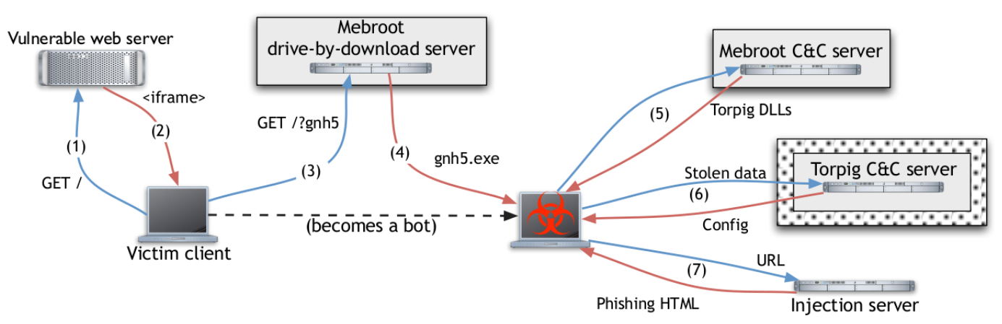
Torpig Architecture
Researchers Infiltrated Here
攻击者在受害网站上部署了重定向链接
Rootkit安装
木马安装
数据窃取
捕获银行密码

Slide 45
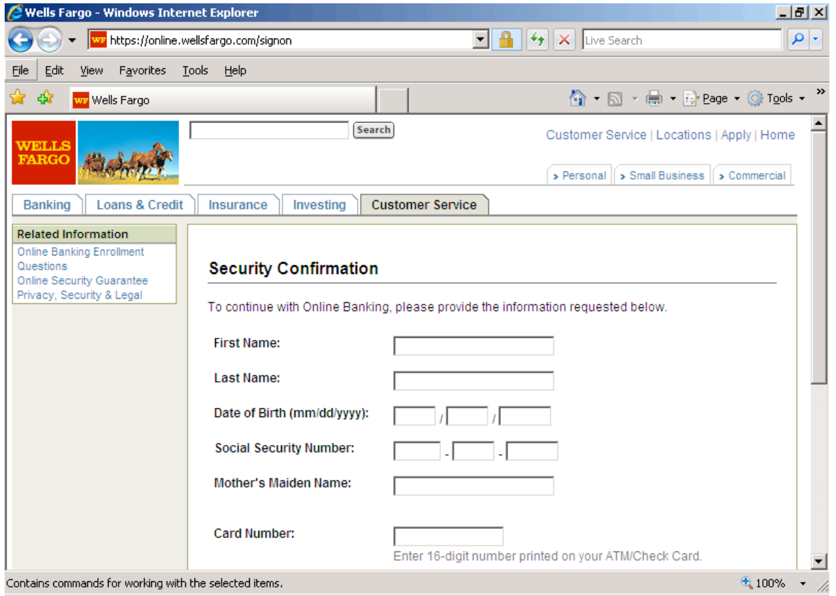
Man-in-the-Browser攻击
注入DLL，窃取输入信息

Slide 46
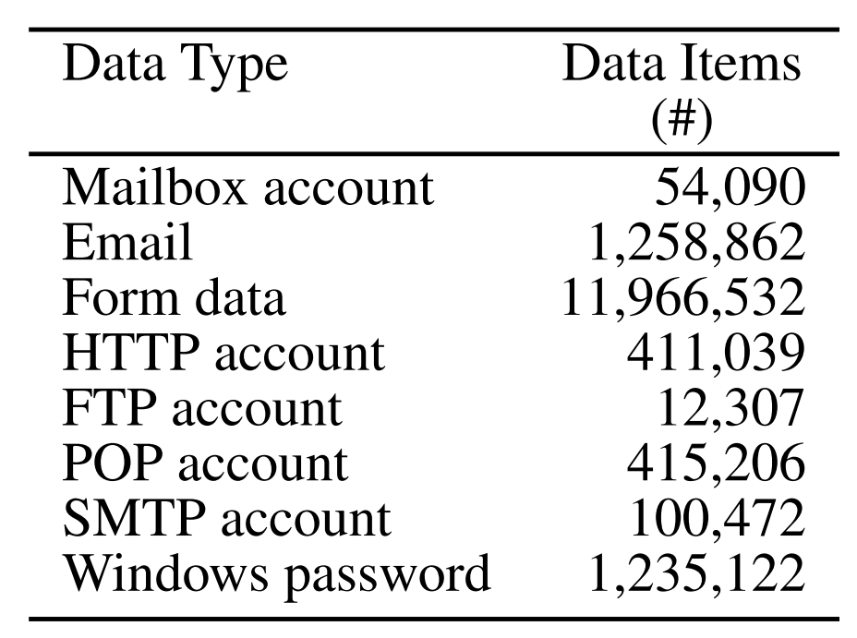
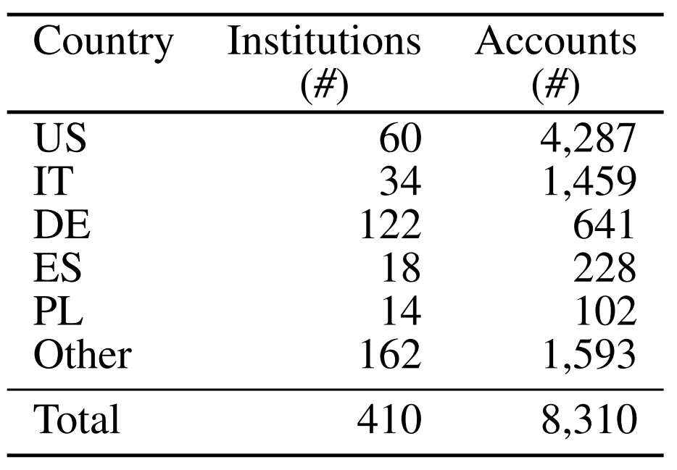
被窃取的数据
2009年1月25日-2月4日
用户账户
银行账户
数据值多少钱？
信用卡每张$0.10-$25, 银行账号每个$10-$1000
总计$83K-$8.3M

Slide 47
如何估算僵尸网络规模?
基于被动收集的方法
蜜罐
使自己的主机感染木马
分析网络流量
查看DNS流量
Domains linked to fast flux C&C
网络流量
采用启发式方法分析ISP的所有流量
None of these methods give a complete picture

Slide 48
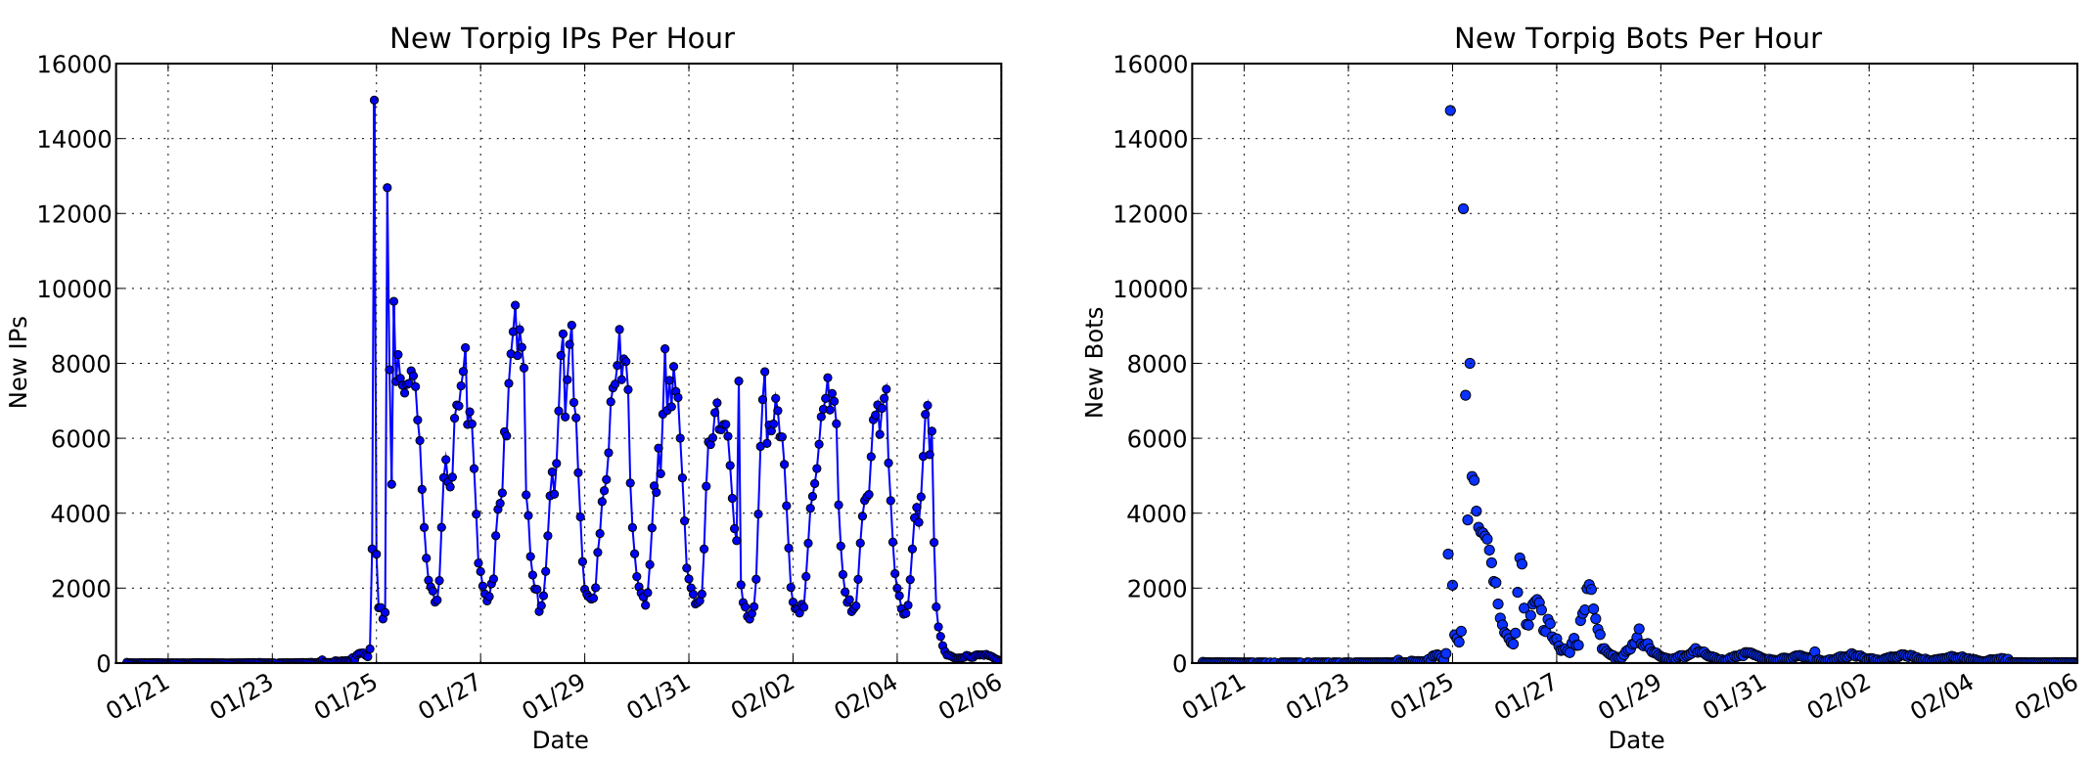
Torpig Botnet的规模
Why the disconnect between IPs and bots?
动态IP、短期 DHCP租约
Casts doubt on prior studies, enables more realistic estimates of botnet size

Slide 49
僵尸网络的用途
Torpig主要用于两个用途
窃取用户账号、信用卡和银行账号
钓鱼
其它获利方法
勒索（DDoS）
垃圾邮件– use the bots as mail servers
点击欺骗和广告注入
比特币挖掘

